Slide 1
Threat Modeling Concepts. Joshep Cortez
Notes:
Vamos de lleno al concepto

Slide 2
Threat Modeling. Agenda
Introduction (What & Why)
Step 1: Modeling the System
Step 2: Finding Threats
Step 3: Addressing Threats (How)
Step 4: Validation
Deliverables

Slide 3


Threat Modeling. It is apply security into SDLC
Notes:
Implica acompañar enfoque de reactivo a proactivo
Idea: Formalizar un poco el esfuerzo
No la hace 1 equipo
Se alcanza entre todos

Slide 4
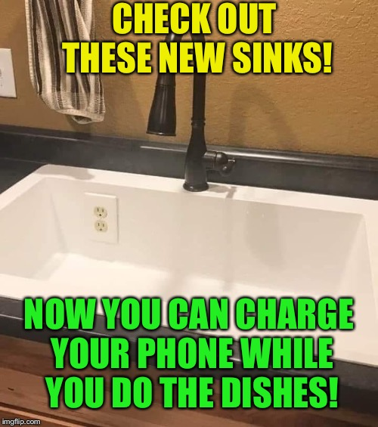
Threat Modeling. Prevent

Slide 5
Threat Modeling High level overview
Threat modeling is a fancy name for something we already do instinctively.
We do/did threat modeling every day:
•When we think about speeding on the road.
•When we put the mobile in our pockets/bag in an unknown street.
•When we think about sneaking something through airport security.
Notes:
En la vida lo tenemos instintivamente incorporado.
Cuando vemos un sitio nuevo de compras
Cuando andamos en auto y pensamos acelerar o parar en una semaforo (vacío) en un horario donde no vemos circulación.
Cuando compramos algo durante un viaje y analizamos como pasar los controles del aeropuerto.

Slide 6
Threat Modeling High level overview
When threat modeling, you usually use two types of models:
•There's a model of what you're building.
•There's a model of the threats of what you are building.
The more information we have, the better we can threat model.
The most important concept of threat modeling is common sense.
Notes:
Mientras más amenazas tengamos en cuenta , mejor.
La idea es convertir las amenazas en sentido común.
Mientras mas común sean las amenazas, la curva de

Slide 7
Threat Modeling Definition
Threat modeling is the use of abstractions to aid in thinking about risks
Notes:
En Resumen esta charla va invitar a pensar en riesgo tempranamente en el ciclo de desarrollo...

Slide 8
Threat Modeling Why?
Prevent security bugs early.
Understand your security requirements.
Engineer and deliver better products.
Address issues other techniques won't, or be more difficult to address.
Example: Static code analysis won't find lack of authentication
Requirement from customers.
Notes:
. Estructura la fase de desarrollo en terminos de seguridad. Incrementa la calidad/skills del desarrollo/desarrollador…
. Un producto mas seguro, claramente tiene una mejora de calidad…
. Resolver un problema de seguridad seguramente es mas facil si se trata al comienzo. Hay ejemplos de la contra reciproca.
. Los customers nos hacen y nos van a hacer cada vez un poco mas, pentests externos a demanda de los mismos clientes.

Slide 9
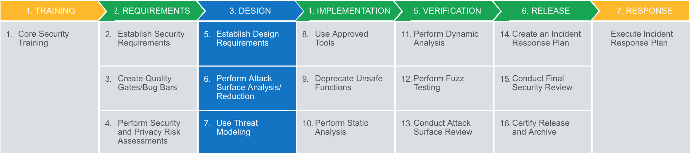
Threat Modeling For Microsoft
Must be performed in the design phase, before developers start the implementation phase
Notes:
Microsoft Approves

Slide 10
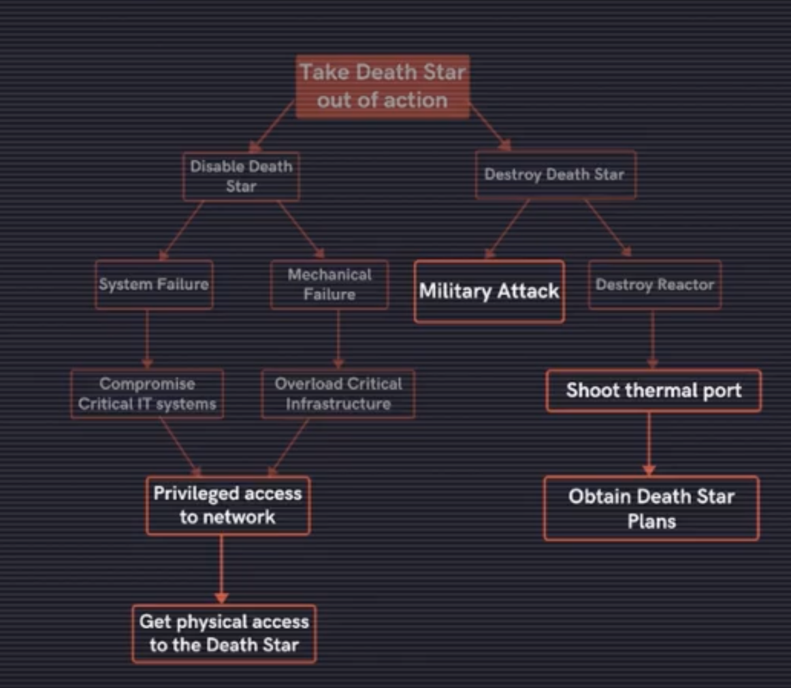

Threat Modeling Fake Example
Notes:
Posiblemente este incompleto
Leer el grafico
Como lograr eso en el dia a dia es la clave de nuestro cambio en el mindset

Slide 11
Threat Modeling How?
We will use a framework that has four steps:
Model the system you're building, deploying, or changing.
What are you building?
Find threats using that model.
What can go wrong with it once it's built?
Address threats using different approaches
What should you do about those things that can go wrong?
Validate your work
Did you do a decent job of analysis?

Slide 12

Threat Modeling
RFI?
XSS?
CSRF?
CSRF?
SQLi?
IDOR?
Command Injection?
Insecure Unserialize?
SSRF?
IDOR?
LFI?

Slide 13
4 Step Framework

Slide 14
Threat Modeling
There are different techniques that can be used in the Four-Step Framework.
For Monotype, we have decided to use the following:
Step 1: Data Flow Diagram (DFD)
Step 2: STRIDE with DREAD
Step 3: Mitigating/Eliminating/Transferring/Accepting
Step 4: Self evaluation
Notes:
Stride: Creado por Microsoft
Dread: Usado por Microsoft, OpenStack, etc..

Slide 15
Threat Modeling
These steps will produce a live document as deliverable that will include the following information:
Threat Model Information
DFD
External Dependencies
Entry Points
Assets
Trust Levels
Threats

Slide 16
Threat Modeling Step1: Modelling the system
To describe the system you are building, we will:
Use diagrams to communicate what you are building. We will use a DFD.
Add trust boundaries to your diagram. Trust boundaries when different people control different things.
Data Flow Diagrams (DFD)
DFD are used to represent how the data flows in a problem, and not the control flow.
After the DFD is completed, it needs to be validated.

Slide 17
Threat Modeling Step1: Modelling the system
Element | Appearance | Meaning | Examples
Process | Rounded rectangle, circle, or concentric circle | Any running code | Code written in C, C#, Python or PHP
Data Flow | Arrow | Communication between processes, or between processes and data stores | Network connections, HTTP, RPC, LPC
Data Store | Two parallel lines with a label between them | Things that store data | Files, databases, the Windows, Registry, shared memory segments
External Entity | Rectangle with sharp corners | People, or code outside your control | Your customer, Microsoft.com
External Entity
Process
Data Store
Data Flow

Slide 18
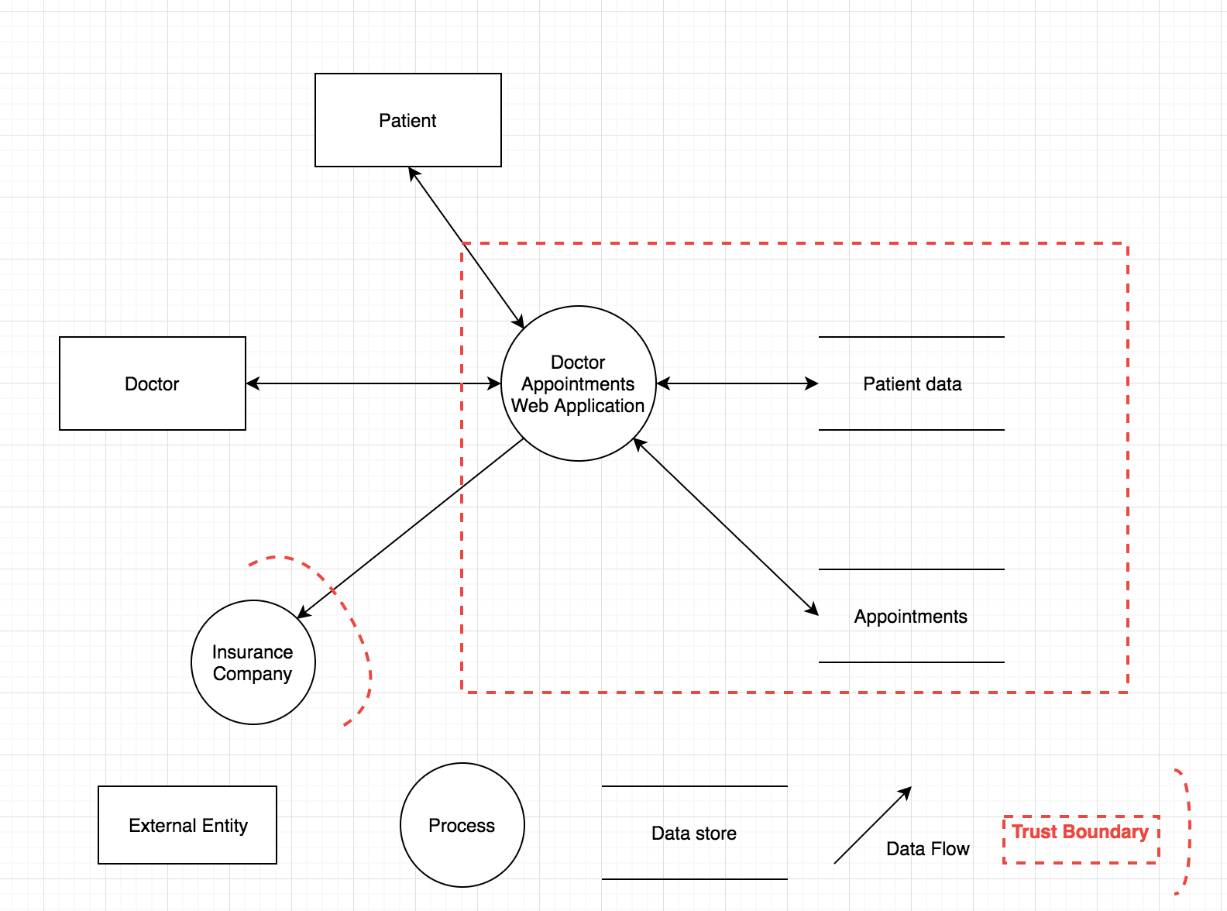
Threat Modeling Step1: DFD 1
Notes:
A trust boundary is any place where entities with different privileges interact.
For Example:
•Accounts
•Network Interfaces
•Different Physical computers
•Virtual Machines
•Organizational boundaries
•Anywhere you can argue for different privileges

Slide 19
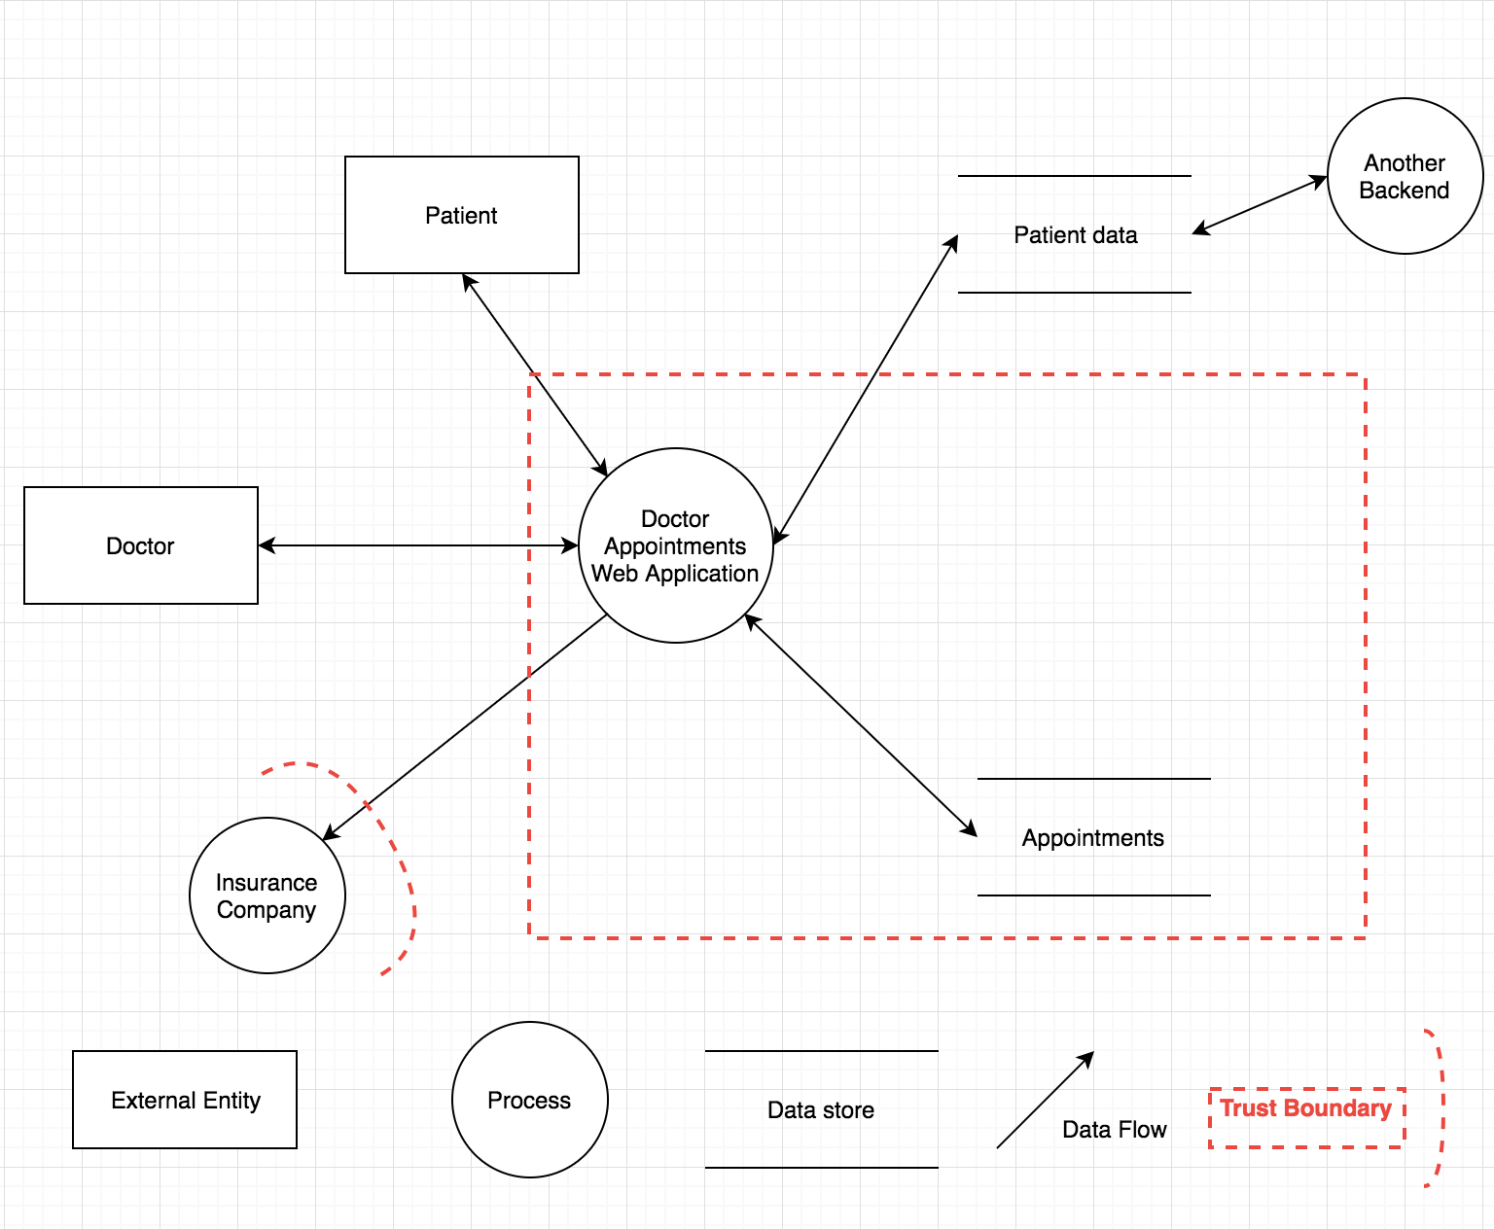
Threat Modeling Step1: DFD 2

Slide 20
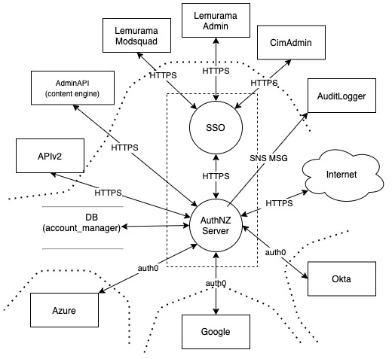
Threat Modeling Step1: DFD - Real Own Example
SFV

Slide 21
Threat Modeling Step2: Finding Threats
Use STRIDE for things that go wrong in security:
•Spoofing •Tampering •Repudiation •Information Disclosure •Denial of Service •Elevation of Privileges
There are a few tips to identify threats:
•Start with external entities. •Never ignore a threat because it's not what you're looking for. •Focus on possible threats.
Notes:
STRIDE define las categorías de las distintas amenazas…
Clasifica cual es la propiedad de seg. potencialmente atacada o violada en caso de que la amenaza se ejecute.

Slide 22
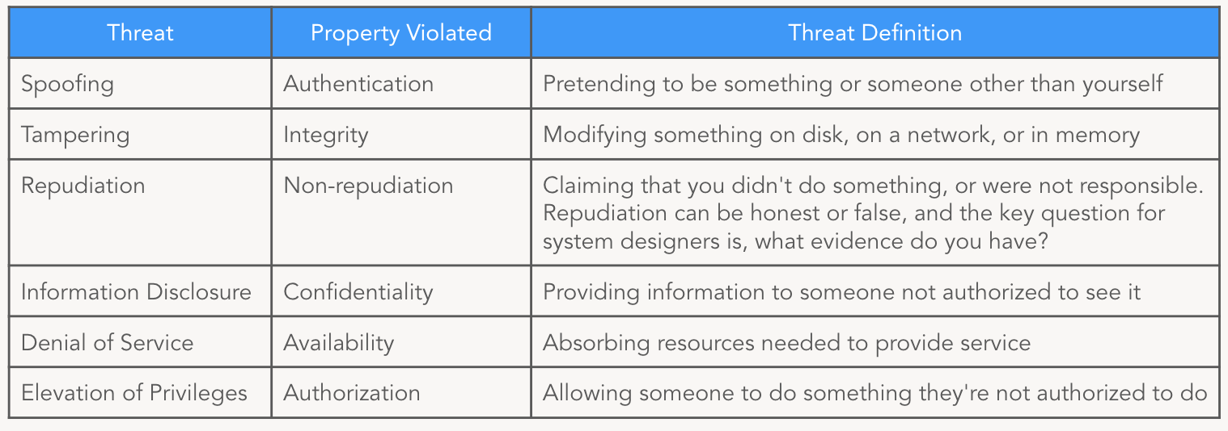
Threat Modeling Step2: Finding Threats
STRIDE was designed to help developers to identify the types of attacks that software tends to experience.

Slide 23
Threat Modeling Step2: Finding Threats
Key concepts to keep in mind:
•Enumerate the things that can go wrong.
•The exact mechanism of how it can go wrong can be developed later.
•Even if there is a mitigation in place, you want to record the threat.
Exit Criteria:
•You have a threat in each type in STRIDE, or
•You have a threat per element of the diagram.
NOTE: these exit criteria does not guarantee a comprehensive list of threats.

Slide 24
Threat Modeling Step2: DREAD
Risk for threats can be calculated using DREAD:
Rating | High (3) | Medium (2) | Low (1)
Damage potential | The attacker can subvert the security system; get full trust authorization; run as administrator; upload content. | Leaking sensitive information | Leaking trivial information
Reproducibility | The attack can be reproduced every time and does not require a timing window. | The attack can be reproduced, but only with a timing window and a particular race situation. | The attack is very difficult to reproduce, even with knowledge of the security hole.
Exploitability | A novice programmer could make the attack in a short time. | A skilled programmer could make the attack, then repeat the steps. | The attack requires an extremely skilled person and in-depth knowledge every time to exploit.
Affected users | All users, default configuration, key customers | Some users, non-default configuration | Very small percentage of users, obscure feature; affects anonymous users
Discoverability | Published information explains the attack. The vulnerability is found in the most commonly used feature and is very noticeable. | The vulnerability is in a seldom-used part of the product, and only a few users should come across it. It would take some thinking to see malicious use. | The bug is obscure, and it is unlikely that users will work out damage potential.

Slide 25
Threat Modeling Step2: Risk example
Points | Level of Risk
12-15 | High
8-11 | Medium
5-7 | Low
Threat | D | R | E | A | D | Points | Level of Risk
Threat1 | 1 | 1 | 1 | 1 | 3 | 7 | Low
Threat 2 | 1 | 3 | 2 | 1 | 3 | 10 | Medium
Threat 3 | 1 | 3 | 3 | 3 | 2 | 12 | High
Threat Modeling

Slide 26
Threat Modeling Step3: Addressing Threats
After step 2, we need to decide the following:
•What do you want to do to address that risk?
•How are you going to achieve that?
In order to address these questions, a few classic strategies exist:
•Mitigating the risk
•Eliminating the risk
•Transferring the risk
•Accepting the risk
•Ignoring
Notes:
Mitigar: cancelar la efectividad del ataque Eliminar: se elimina la posibilidad de intento de ejecucion de la amenaza
Transfering: Se delega el riesgo de efectividad de ataque a un producto, servicio, a una persona …
Acept: Se decide convivir con el riesgo.

Slide 27
Threat Modeling Step3: Addressing Threats
There are different alternatives for mitigating a risk:
•Changing the design:
•Eliminating a feature to decrease the risk •Adding a feature to decrease the risk
•Applying standard mitigation technologies:
•Platform-provided mitigations •Developer-implemented mitigations •Operational mitigations •Designing a custom mitigation

Slide 28
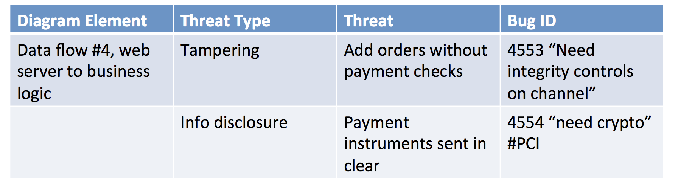
Threat Modeling Step3: Threat Tracking Table Example

Slide 29
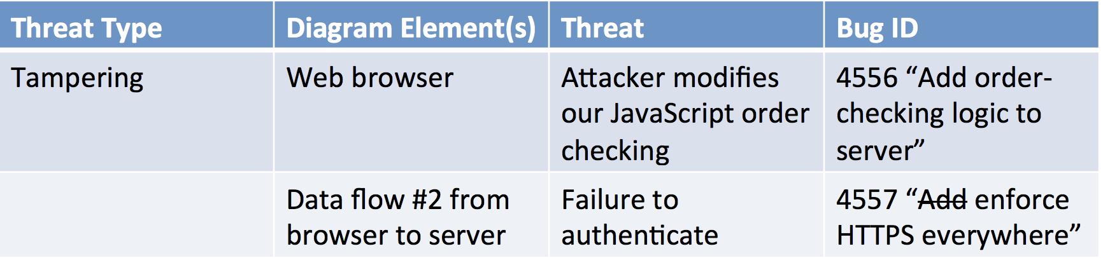
Threat Modeling Step3: Threat Tracking Table Example2

Slide 30
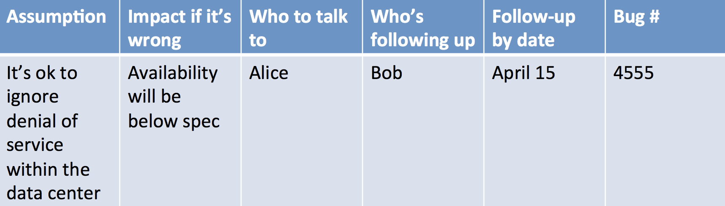
Threat Modeling Step3: Accepting threat Example

Slide 31
Threat Modeling Step3: Accepting threat Example
Impact is sometimes so obvious it’s not worth filling out
Who to talk to is not always obvious, it’s ok to start out blank
Tracking assumptions in bugs helps you not lose track
Treat the assumption as a bug – you need to resolve it

Slide 32
Threat Modeling Step4: Validation
Checking the Model:
•Is it complete?
•Is it accurate?
•Does it cover all the security decisions we made?
•Can I start the next version with this diagram without any changes?
Notes:
Completo ? Preciso?
Cubre las decisiones ?

Slide 33
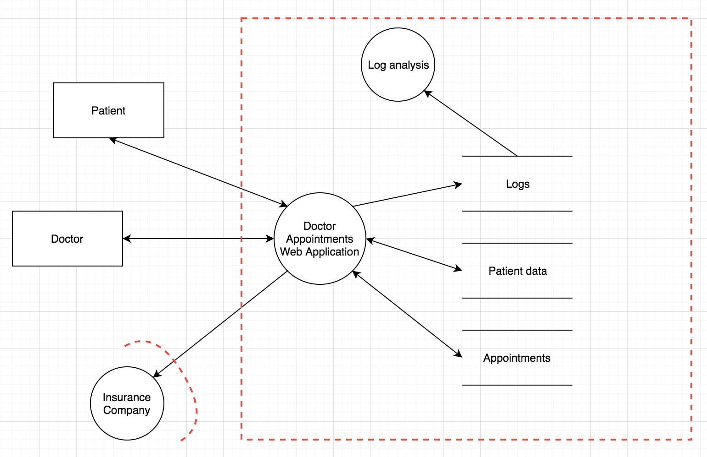
Threat Modeling Step4: Checking the work

Slide 34
Deliverable examples

Slide 35
Deliverables • Threat Model Information
Information related to the threat model
Threat Model Information
Application Name | Application Name
Application Version | Application Version
Description | Description
Participants | Participants
Reviewer | Reviewer
Threat Modeling

Slide 36
Deliverables • External Dependencies
Elements that cannot be controlled by the development team
External Dependencies
ID | Description
1 | Description 1
2 | Description 2
... | ...
n | Description n
Threat Modeling

Slide 37
Deliverables • Entry Points
The interfaces through which potential attackers can interact with the application or supply it with data
Entry Point
ID | Name | Description | Trust Level
1 | Name 1 | Description 1 | (1) Trust Level (2) Trust Level … (m) Trust Level
2 | Name 2 | Description 2 | (1) Trust Level (2) Trust Level … (m) Trust Level
... | ... | ... | ....
n | Name n | Description n | (1) Trust Level (2) Trust Level … (m) Trust Level
Trust levels represent the access rights that the application will grant to external entities
Threat Modeling

Slide 38
Deliverables • Assets
Something that the attacker is interested in. Assets are essentially threat targets.
Assets
ID | Name | Description | Trust Level
1 | Name 1 | Description 1 | (1) Trust Level (2) Trust Level … (m) Trust Level
... | ... | ... | ...
1.n | Name 1.n |  | (1) Trust Level (2) Trust Level … (m) Trust Level
... | ... | ... | ....
n | Name n | Description n | (1) Trust Level (2) Trust Level … (m) Trust Level
Threat Modeling

Slide 39
Deliverables • Document the Threats
Threat
ID | Threat ID
Description | Description
Category | Category
Threat target | Threat target (Asset at risk)
Risk | Risk
Attack Technique | Attack Technique
Countermeasure | Countermeasure
Addressing | Addressing (Mitigate, Eliminate, Transfer, Accept)
Ticket ID | Ticket ID
Threat Modeling

